Slide 1
Rent & tenants
Comments

Slide 2
Input
Have two datasets “Rent contracts” and “Payment transactions”
See data/contracts.csv and data/transactions.csv
Contracts contain:
Tenant info
Duration
Account number
Transactions contain:
Account number
Payment details
Amount paid

Slide 3
The Problem
1. Process and Cleanse the data
2. Classify tenants depending on reliability
3. Predict tenants reliability

Slide 4
Structuring and cleansing

Slide 5
Structure
Each valid transaction belongs to one contract
Each valid contract is connected to one Person/Tenant
Represent the data as a FOREST of trees with:
Tenants as roots
Contracts on the first level
Transactions on the second
Tenant
Tenant
Tenant
Contract
Contract
Transaction
Transaction
Transaction

Slide 6
Transaction content
It contain all information relevant to the actual money transfer
Plus a link to a contract
Data analysis show that there are 3 payment methods passible (See the code snippet)
class Transaction: class Type(Enum): CASH = 1 DIRECT_DEBIT = 2 BANK_TRANSFER = 3 contract: Contract date: datetime amount: float method: Type

Slide 7
Contract content
Contains basic contract information
As well as a link to a Tenant
A list of links to the transactions
A set of transaction payments in the form:
Key = date
Value = transaction amount
class Contract: id: int postcode: str rent: float start: datetime end: datetime person: Person transactions_obj: list payments: dict

Slide 8
Person content
Person data is gathered from the contracts file as a unique combination of the
Name and
Date of birth
The ZIP code is intentionally omitted for this challenge since it is not a unique person identifier and it is not clear how the ZIP code encodes the real geo-location
class Person: first_name: str last_name: str dob: datetime contracts: list

Slide 9
Reading the data
Read Contracts file
create unique persons/tenants
Create Persons objects
Connect each contract to a person
Read Transactions files
Find existing contracts by id (if any)
Connect Transactions objects to the contracts

Slide 10
Preliminary observations
Persons/tenants: 9951
Contracts with transactions: 11112
Contracts with no transactions: 53
Total transactions with contract: 258904
Transactions with no contract: 2424
Average contracts for multi-contract person 2.06
Persons with one contract: 1142
Persons with one payment method 9607
Persons with multiple payment methods 344

Slide 11
Evidences
There are contracts without an ending date – treat those as active – the ending date will be determined the last child transaction day
ALL the transaction from the data has their date WITHIN the parent contract duration range
All the data in files has valid types (i.e. no NaN or number-string mismatches)
Transaction
Transaction
Transaction
Contract timeline

Slide 12
Evidences
First Transaction:
22/06/2015
There are contracts that have their first transaction few years after the start – treat those as an incomplete data (and NOT as a non-payment period)
The start for such contracts will be set-up as most recent months and day that does not exceeds the first transaction
Start 12/03/2014
New start 12/06/2015
No transactions here
Contract timeline
Maximum Integer number
of months
Less than
a month

Slide 13
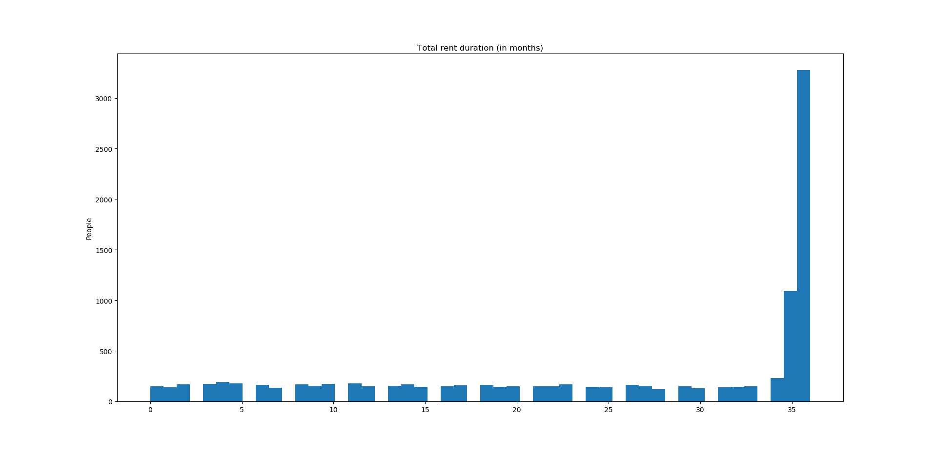
Tenants rent duration
% of people with rent duration not greater than
3 months 6.37
6 months 11.77
12 months 21.43
18 months 30.94
24 months 40.14

Slide 14
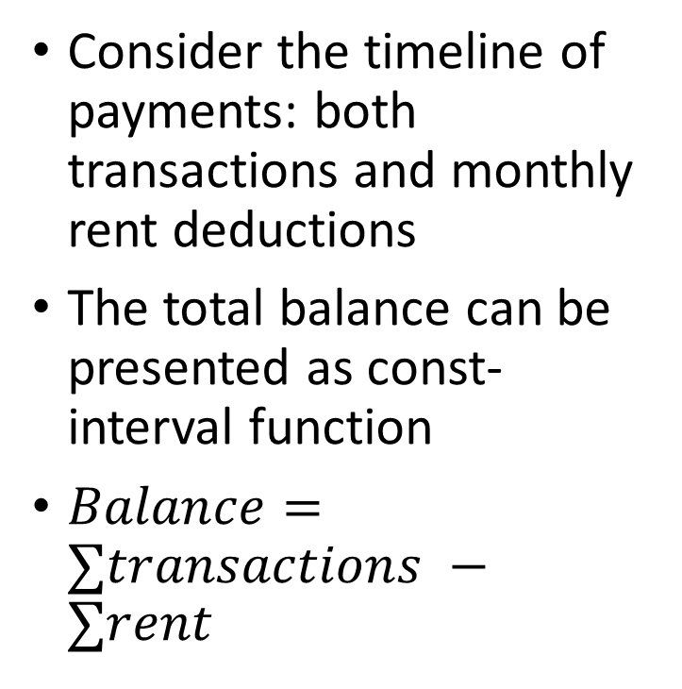
Balance function
Consider the timeline of payments: both transactions and monthly rent deductions
The total balance can be presented as const-interval function
$Balance=∑transactions −∑rent$
Balance
Rent day
Time
Positive transaction

Slide 15
"Happy families Good tenants are all alike; every unhappy family bad tenant is unhappy bad in its own way."
Leo Tolstoy

Slide 16
Negative balance
In order to analyze how reliable is a tenant we consider the balance graph for each contract
only the negative part
Balance is calculated relative to the rent amount
-1 = a debt in one rent amount
Balance
No debt
Debt
Time

Slide 17
debt features
Features:
Max value
Max width
Max area
Number of cycles
Average width
Average value
Average area
Green/red ratio
Etc.
Width/length of debt cycle
Balance
Time
Value/Height of debt
Area/power
Area/power = Debt-day (similar to kilowatt hour)

Slide 18
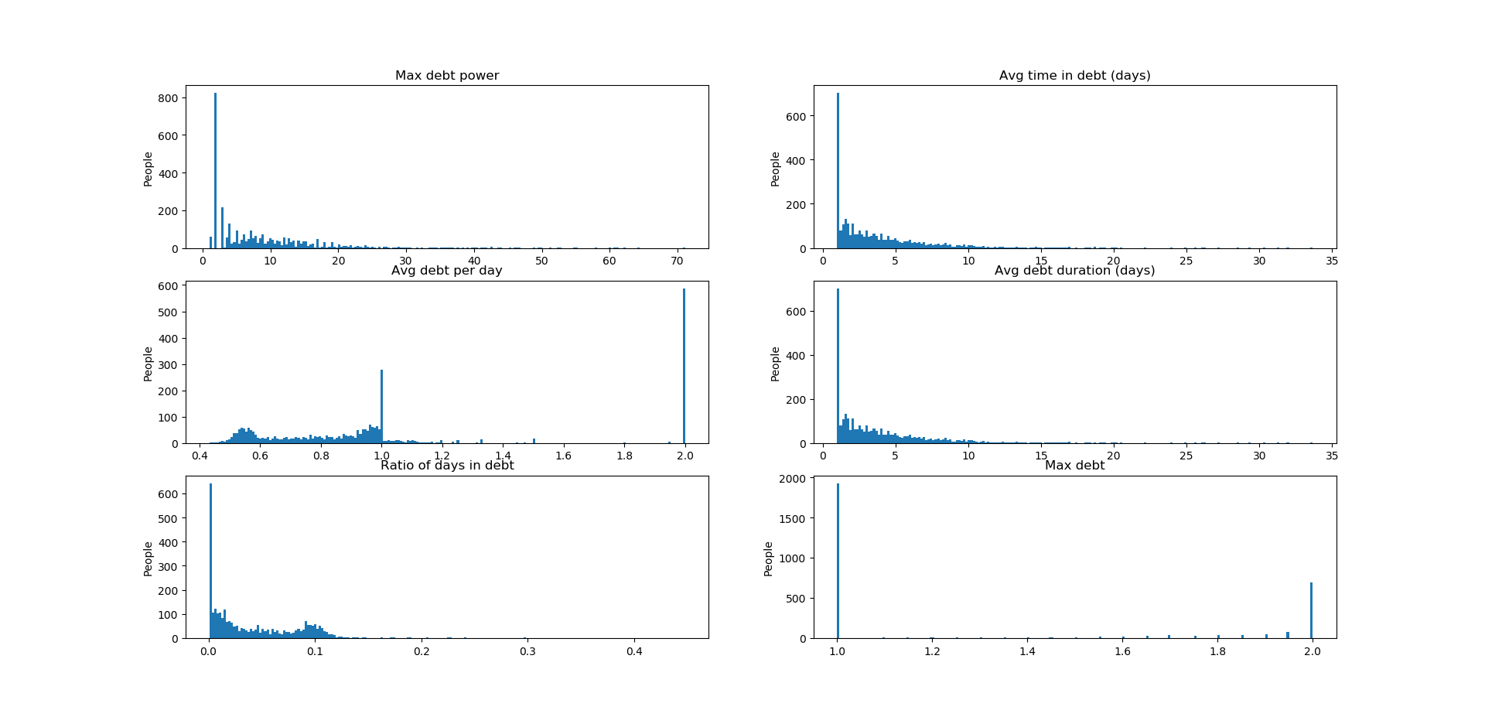
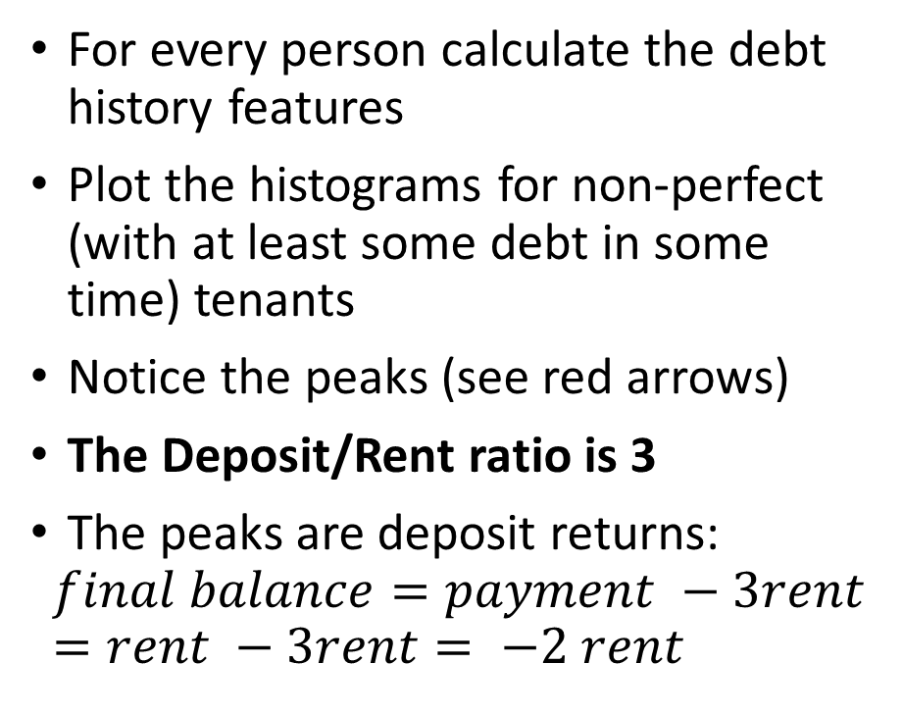
Plot some histograms
For every person calculate the debt history features
Plot the histograms for non-perfect (with at least some debt in some time) tenants
Notice the peaks (see red arrows)
The Deposit/Rent ratio is 3
The peaks are deposit returns:
$$final balance=payment −3rent=rent −3rent= −2 rent$$

Slide 19
Rent return adjustment:
If the balance becomes -2 after the last transaction on the last day of the contract – we consider is as a deposit return and do not add this data to the debt
Contracts with deposit returns 665

Slide 20
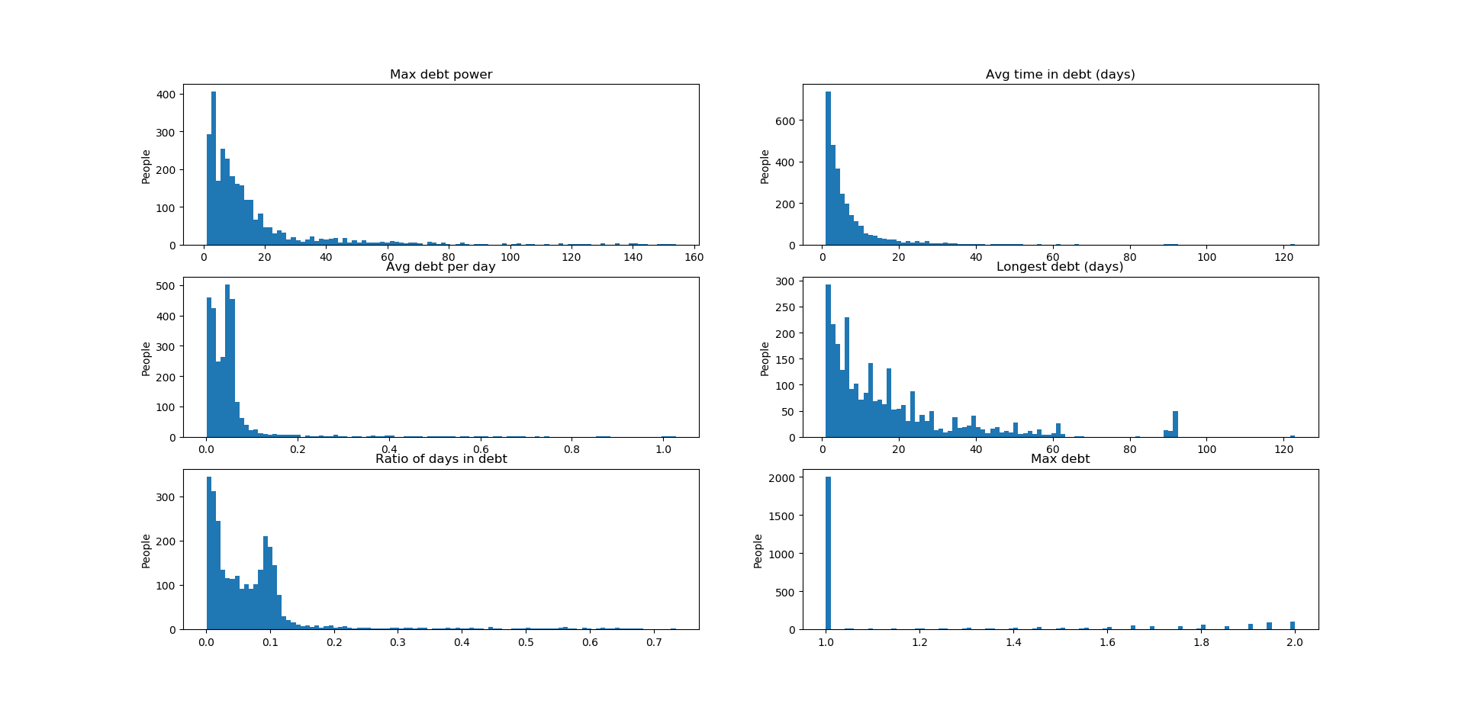
Plot some histograms (again)
Those are definitely evictions

Slide 21
Evictions:
Assume deposit returns are already considered and removed from the data
If the balance is negative after the last transaction on the last day of the contract – we consider is as an eviction indicator
Tenants with an eviction: 113
Most of them were evicted after 2, 3 or 4 months of non-payment: see the histogram on the next slide

Slide 22
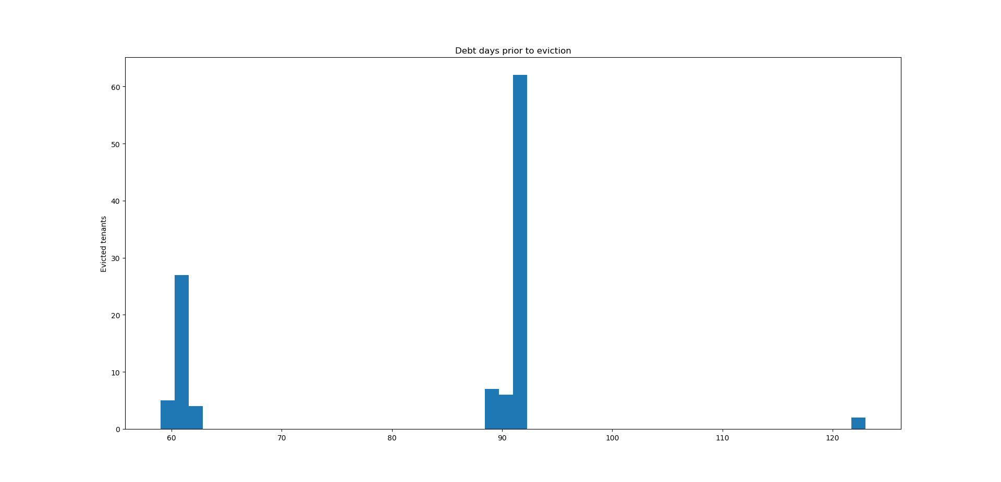
Payment delay histogram for evicted
Evicted after two months of non-payment
(including notice period)
Evicted after a long (> 1 month) non-payment period

Slide 23
Labels and Features

Slide 24
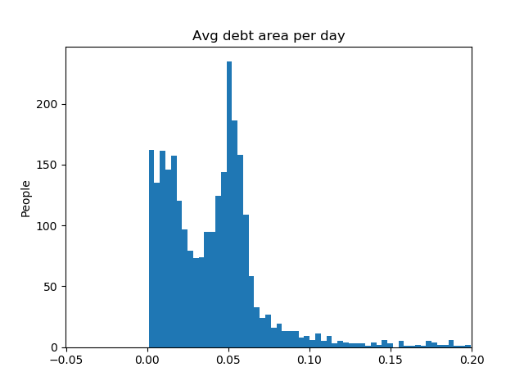
Labeling of tenants
Tenants with no debt history : GOOD
Tenants with evictions: BAD
Notice a distinctive split for the following histogram:
Other tenants are either AVERAGE or BAD depending on the following split: Average debt area per day = 0.031
Labeling window: ALL AVAILABE TIMELINE FOR THE TENANT

Slide 25
Features for regression input: totally 10
~85% of tenants have rent duration > 9 month
For each contract split each contract duration into integer number of 9 months periods
Evaluate debt features for each period
Label with the true label for the corresponding Tenant
Add other features:
Age
Most frequent payment method
Number of contracts
Contract timeline
9
9
9

Slide 26
Regression

Slide 27
Input data
Sample row of the input data (header on top):
Columns: ['contracts', 'payment_method', 'avg_area_act', 'avg_area_all', 'avg_area_cyc', 'avg_act_length', 'ratio_active', 'max_active', 'max_area', 'age', 'label’]
GOOD, AVERAGE, BAD sizes: 14610, 4055 and 5435
Contracts | payment_method | avg_area_act | avg_area_all | avg_area_cyc | avg_act_length | ratio_active | max_active | max_area | age | label
1 | Type.DIRECT_DEBIT | 0.983333 | 0.021612 | 1.966667 | 2 | 0.021978 | 1 | 3 | 29 | Label.AVERAGE

Slide 28
Task
Create and train the classifier in to predict the LABEL based on all other features

Slide 29
Split data and equalizing the classes
Train data size: 16870 (70%)
Test data size: 7230 (30%)
GOOD, AVERAGE, BAD ratios in the train data: 0.60 : 0.17 : 0.23
Need to oversample to get the equal number in each of 3 classes
Use SMOTE algorithm for the oversampling
After SMOTE each class contains 10198 10198 10198 rows

Slide 30
Logistic regression (training)
Feed the logistic regression with the data and get the fit:
1. Feature ranking output – all of the selected features are significant
2. Fit the model
3. Hope for convergence
model = LogisticRegression(solver='lbfgs', multi_class='multinomial', max_iter=2000) result = model.fit(X_train, y_train)

Slide 31
Validation
Success score on the TEST data (see the split): 82.4%

Slide 32
Validation
Confusion matrix for the TEST (see the split) input:
Observation: the trained classifier prefers to lower the goodness of the tenant
 | GOOD(true) | AVERAGE(true) | BAD(true)
GOOD(predicted) | 4379 | 33 | 0
AVERAGE(predicted) | 551 | 584 | 51
BAD(predicted) | 404 | 232 | 996

Slide 33
Code:
The code is located in the root of the provided directory and in the src folder
Two main python files:
prepare_data.py – reads the data, analyzes it and creates the final input for the regression model in /data/labels_features.csv
regression.py – trains and validates the model based on the provided data
Run them in the order

